Slide 1


ELK ML
-- Apoorv Gupta

Slide 2


Categories :
Anomaly detection
Categorization analysis
Data Visualizer
Regression
Classification
Outlier detection

Slide 3
Anomaly Detection
It constructs a probability model and can run continuously to identify unusual events as they occur.
The anomaly score (severity) is a value from 0 to 100, which indicates the significance of the observed anomaly compared to previously seen anomalies. Highly anomalous values ​​are shown in red.
Anomalies with medium or high impact on multiple time buckets are represented with a cross symbol instead of a dot.

Slide 4
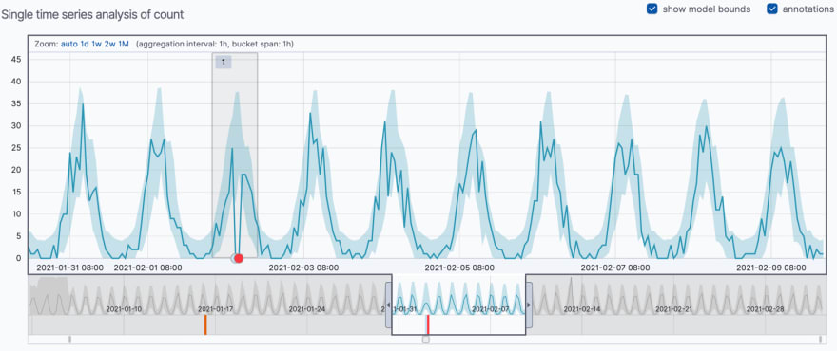
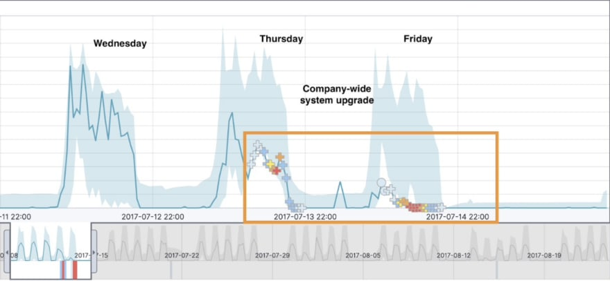
The blue line in the chart represents the actual data values. The shaded blue area represents the bounds for the expected values.
In order to provide a sensible view of the results, an anomaly score is calculated for each bucket time interval (we use the concept of a bucket to divide up a continuous stream of data into batches, between 10 minutes and 1 hour, for processing).
When you review your machine learning results, there is a multi_bucket_impact property that indicates how strongly the final anomaly score is influenced by multi-bucket analysis; anomalies with medium or high impact on multiple buckets are represented with a cross symbol instead of a dot.
We can shoot message , if high severity anomalies cases occur.

Slide 5
Categorization
It is a machine learning process that tokenizes a text field, clusters similar to data together, and classifies it into categories
Categorization-->
Step 1 - Remove mutable text
Step 2 - cluster similar messages together
Step 3 - Count per time bucket
If specific logs was coming but now not coming, then notification will be send and vice versa.

Slide 6
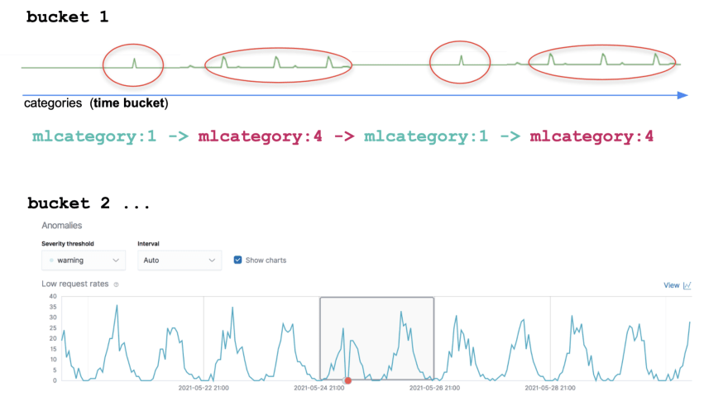
->mlcategory:1
Log message: Invalid User Id in Headers.
->mlcategory:2
Log message: Invalid Alias.
As an example, at a specific time bucket, we could see an mlcategory:1 followed by an mlcategory:2, twice:
mlcategory:1 -> mlcategory:2 -> mlcategory:1 -> mlcategory:2.

Slide 7
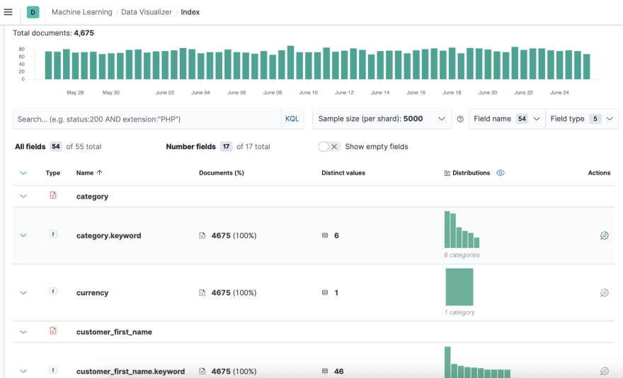
Data Visualizer

Slide 8
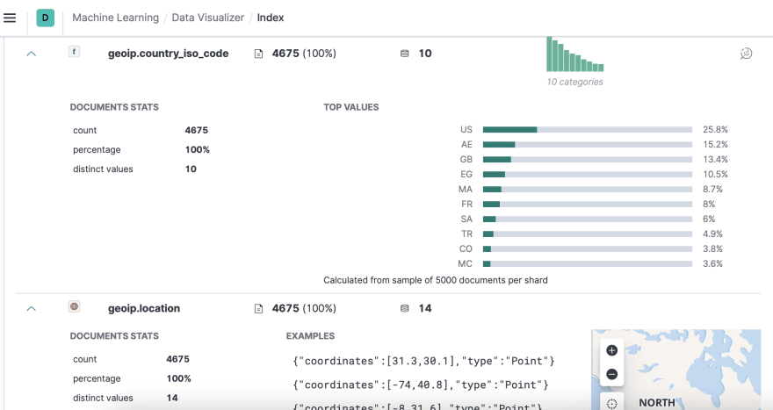
Thing that stands out is that these customers are from different countries and states, we are a global ecommerce company. But how does this population spend their money? Do they behave similarly? What location payment getting high or low?

Slide 9
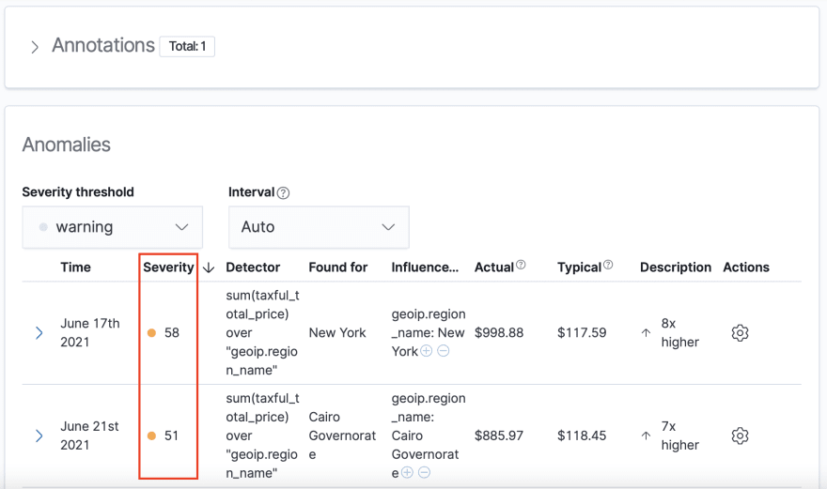
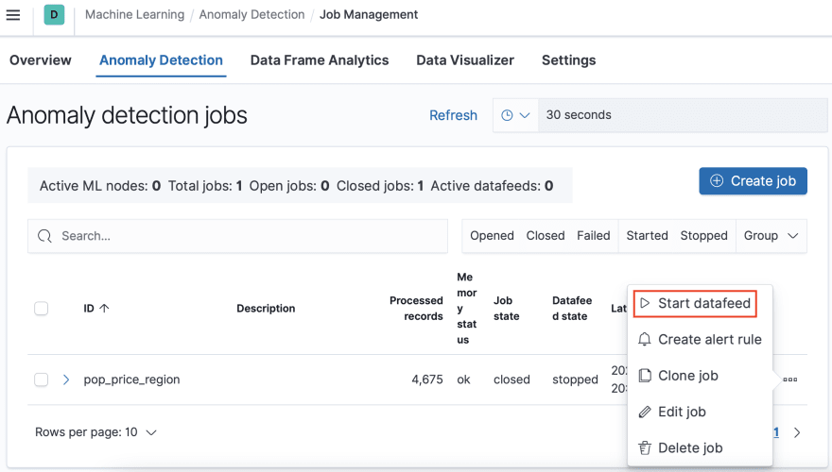
We can also add the Bucket Span( usually the Bucket Span is 15 minutes). If you want to leave this job running, you just need to click ‘Start datafeed’, you will set the start date and set the end time, select no end time to search in real time. You can also create alerts based on severity.

Slide 10
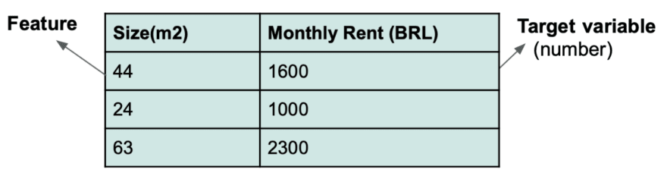
Regression
Regression makes predictions on your data after it determines certain relationships among your data points.
For example, suppose we are interested in finding the relationship between payment data and state or city, to do this we need to find the relationship between a number of features and a target variable to know if the target variable can/can't be explained by the feature(s).
After this, we can predict the amount of payment will be done at specific state or city.

Slide 11
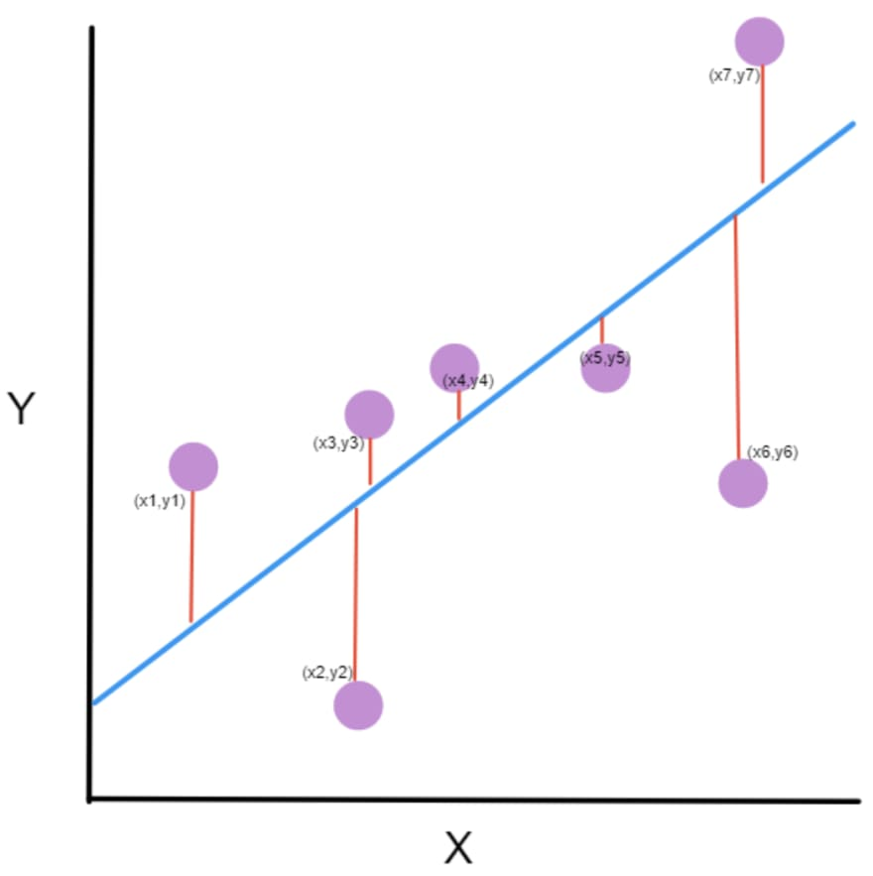
The two measures that we can use to evaluate regression in the stack is R2 and MSE: R Squared (ranges from 0 to 1 | the higher the better): measures goodness of fit, to know if the target variable can/can’t be explained by the feature variable, 1 is a perfect fit. Mean Squared Error (ranges from 0 to 1 | the lower the better) - measures the average error between the actual datapoints and the predicted data points telling you how close a regression line is to a set of points. It does this by taking the distances from the points (purple dots) to the regression line (blue line), these distances (red lines) are the “errors”, and squaring them.

Slide 12
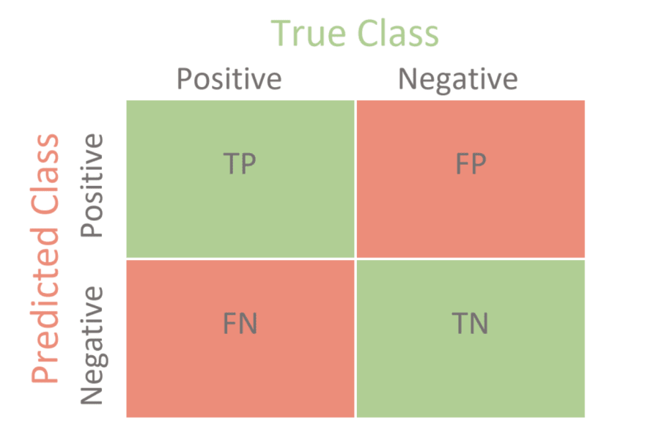
Confusion Matrix
Example –
Predict amount of payment will be done

Slide 13
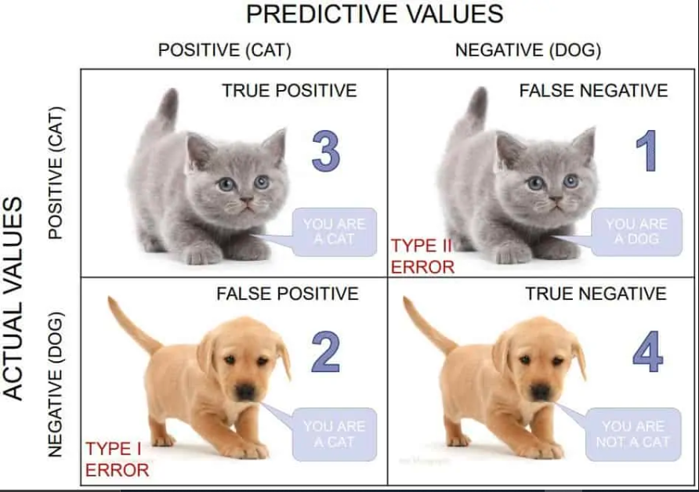
Classification
Classification predicts the class or category of a given data point in a data set.
In the classification analysis we are predicting class probabilities such as yes / no, true / false, spam / not spam, while in the regression analysis we are predicting continuous values such as price and salary.
In our case, we can use it as , whether a user is spam or not, whether a specific condition will happen or not; like will today registration count would reach 1000 or not and many more…

Slide 14
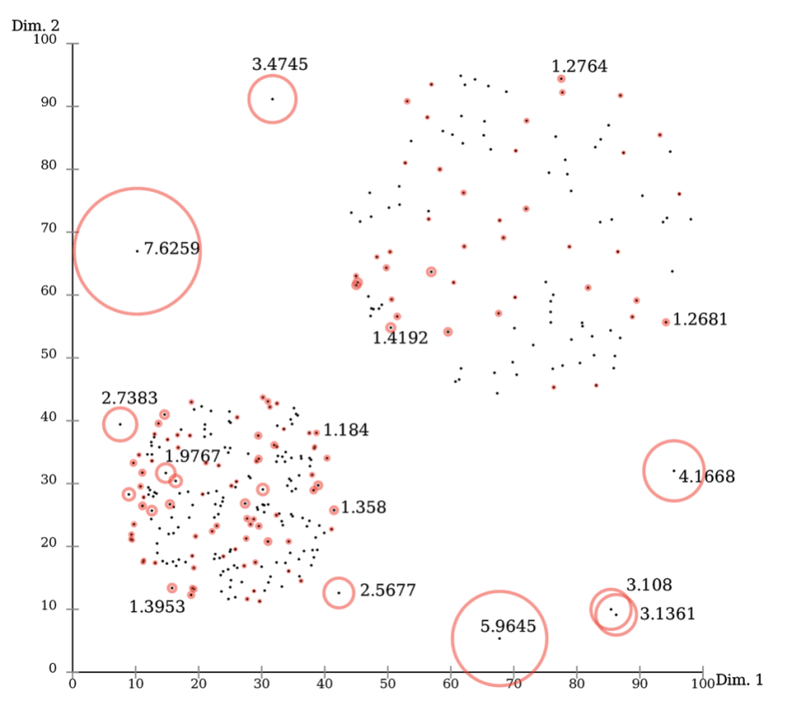
Outlier detection
With Outlier Detection we are looking at clusters of data and evaluating density and distance using multi-variate analysis and there are no buckets.
Outliers may denote errors or unusual behavior. In the Elastic Stack, we use an ensemble of four different distance and density based outlier detection methods, based on this approach, a metric is computed called local outlier factor for each data point. The higher the local outlier factor, the more outlying is the data point.

